Slide 1

SYLIP CORPORATION
ANNUAL SALES PERFORMANCE REPORT FROM 2010 – 2017
Data type: Annual sales data
Reporting cycle: 2010 – 2017
Presented by: Group A

Slide 2
JULY 2024 CLASS_GROUP A
Omoede Osawaru
Olaniyan Saheed
Festus Aidoo
Chimereogo Mmesoma Iwuchukwu
Adedeji Ogundipe
Abimbola Ajana

Slide 3
BENCHMARKS
Annual targets
Total cost - £1,500,000.00
Total profit - £2,500,000.00
Sales revenue - £3,000,000.00
Sales units - 15,000

Slide 4
KEY PERFORMANCE INDICATORS (KPIs)
Total Quantity Sold Year-by-Year Per Item Type
Total Annual Revenue
Average Annual Profit
Year-on-Year Revenue Growth Rate

Slide 5
TERMINOLOGIES
The dataset represents Sylip Corporation (SC) sales data for the years 2010 to 2017.
The dataset also includes such variables as regions, countries, item types, orders, total revenue, total cost, amongst others.
In all, SC boasts of 76 countries across 7 global regions where its 12 various product types are offered over a period of 8 years.

Slide 6
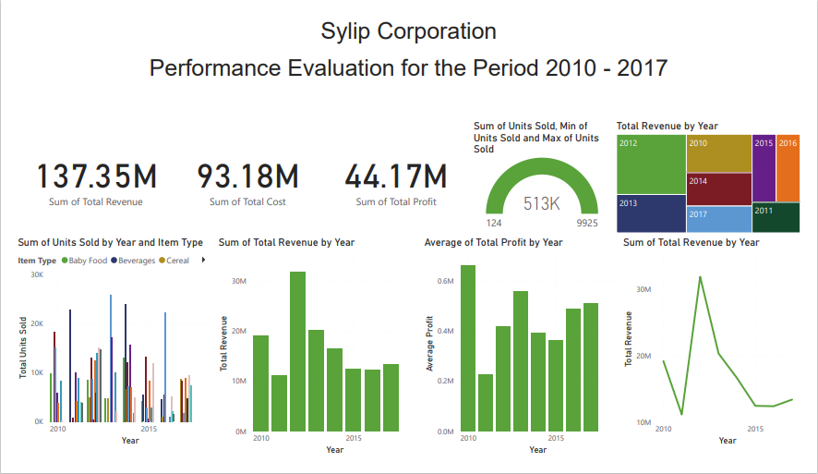
DASHBOARD REPORT SUMMARY

Slide 7
KPI 1: TOTAL ANNUAL QUANTITY SOLD PER ITEM TYPE
Summary
The highest total sales quantity of 92,040 for all items occurs in 2014.
Cosmetics records the highest annual sales quantity of 25,728 in 2013.
15000 annual sales quantity target is well exceeded.
Clothes and Meats record the highest and lowest total sales quantity of 71,260 and 10,675 respectively for all the years.

Slide 8
KPI 2: TOTAL ANNUAL REVENUE
Summary
Total income earned for the reviewed period is £137,348,768.31.
The highest revenue of £31,898,644.52 generated in a singular year occurs in 2012.
2011 has the lowest revenue of £11,129,166.07.
Annual target of £3,000,000 is consistently exceeded.

Slide 9
KPI 3: AVERAGE ANNUAL PROFIT
Summary
The year 2010 records the highest average profit at £662, 956.74 followed by £559,618.34 recorded in 2013.
Contrarily, the average profit of £228,417.35 recorded in 2011 is the lowest.

Slide 10
KPI 4: YEAR-ON-YEAR REVENUE GROWTH RATE
Summary
Revenue declines in 2011 from the previous year’s performance of £19,186,024.92 by 41.99%.
It, however, rises by 186.62% in 2012 to £31,898,644.52.
In 2013, revenue falls again by 36.27% and remains flat within the average of £13,000,000 subsequently.

Slide 11
CONCLUSION
Targets for all KPIs have been well achieved.
Total income of £137,348,768.31 is earned.
Total sales quantity of 512,871 across 12 product offerings recorded.
The best performing year in revenue terms is 2012, which is preceded by the worst performing year 2011.
Beverages, clothes and cosmetics appear the company’s best-performing product offerings during the period.
From 2014, sales growth has been summarily flat.
Annual average profit per order range between £228,000 and £663,000 over the period.

Slide 12
RECOMMENDATION
Further industry and other analyses should be considered for better performance understanding.
The reason for the poor performance in 2011 across various KPIs should be investigated.
SC should endeavour to justify the continual offering of Meats and those similar products with relatively poor performances in terms of sales quantity.

Slide 13
Thank you

